Slide 1
Accounts Payable Training

Slide 2
Accounts Payable Mission & Information
The primary mission of Accounts Payable is to ensure all payments processed by the department are done timely, accurately, and in compliance with the University; along with the federal and state rules and regulations, with excellent customer service and a commitment to continuous process improvement.
The following are some examples of the procedures in place for requesting payments for Vendors, Memberships, Subscriptions, Accreditation Fees, Agency, Stipends, and other types of payments.
All forms, instructions, and other pertinent information can be found on the Controller’s web site at http://www.atu.edu/controller/forms.

Slide 3
Accounts Payable Request for Payment
Purchase Order Check Request
Non-Purchase Order Check Request
The following documents are required and must be received by Accounts Payable in order to process payments.
Purchase Order (signed & dated by authorized supervisor)
Original Invoice
Upon receipt of the above documents, Accounts Payable will process the invoice for payment in accordance with the established payment terms for that vendor. We ask that all purchase orders are forwarded to Accounts Payable directly after receiving invoice. Please send the invoice and PO together. When applicable, contracts or quotes are required.
Check Requests are not commonly used for goods and services, other than for Agency. However, if a check request is approved for use the following documents are required and must be received by Accounts Payable in order to process payments for non-purchase order check requests.
Check Request Form
Invoice or Itemized Receipts
Memo from Department Supervisor (in certain circumstances, *please see slide eight (8) for additional information)
If approved, we ask that all check requests and documents are forwarded to Accounts Payable directly after receiving goods or services.
An explanation of required documents to follow.

Slide 4
Supporting Documentation
Purchase Order
Acceptable Documentation:
Invoice (original)
Vendor name, address, & phone number
Invoice date & number
Purchase order number
Description of goods/services
Amount of goods/services
Sales tax (if applicable)
Shipping charges (if applicable)
Total amount due
Additional Supporting Documentation (if applicable):
When available – forward packing slips with PO.
When applicable – quotes or contracts are required. However, a quote or contract does not take the place of an invoice.
Unacceptable Documentation:
Personal Checks or Bank Statements
Credit Card Statements or emails without above info
Non-Purchase Order Check Request
Acceptable Documentation:
Invoice (original)
Vendor name, address, & phone number
Invoice date & number
Purchase order number
Description of goods/services
Amount of goods/services
Sales tax (if applicable)
Shipping charges (if applicable)
Total amount due
Itemized Receipt
Memo (*please see slide eight (8) for additional information)
Unacceptable Documentation:
Personal Checks or Bank Statements
Credit Card Statements or emails without above info
Agency Check Request
Please visit the Forms page at www.atu.edu/controller for Agency check request instructions.

Slide 5
Supporting Documentation Examples
Sample Invoice
Sample Handwritten Invoice
Vendor name, address, & phone number
Invoice date & number
Purchase order number
Description of goods/services
Amount of goods/services
Sales tax (if applicable)
Shipping charges (if applicable)
Total amount due
Handwritten invoices require all information as other invoices, as well as, a company representative signature.
If an incomplete invoice is received, it will be returned for corrections to the appropriate department.

Slide 6
Purchase Orders
Prior to making a purchase with a vendor, a requisition must be entered and a purchase order created. For questions regarding requisitions/PO’s please contact Procurement.
Upon receiving goods/services, print purchase order
Complete bottom right portion of the purchase order:
Enter the date goods/services are received
Mark Final, if order is complete, or Partial, if order is incomplete. You must send another signed PO over with each invoice per order until all items are received and the PO is marked final.
Enter date of approval
Departmental Supervisor signature is required and can not be the same as the contact person. An original wet signature or DocuSign is acceptable, but a typed signature alone can not be accepted.

Slide 7
Paperclip if sending originals or email the following forms together to: Accounts Payable acctspayable@atu.edu
Signed and approved Purchase Order
Invoice
*Packing Slip
**Quote (if applicable)
**Contract (special services)
*If available – forward packing slips with purchase order.
**When applicable – quotes or contracts are required. However, a quote or contract does not take the place of an invoice.
Contract (special services)
Quote (if applicable)
Invoice

Slide 8
Non-Purchase Order Check Request
Examples of check requests that do not require a purchase order are:
Agency
Stipends
Postage
Select athletics, such as game workers
A Request for Check Form will need to be completed and the following attached:
Invoice
Itemized receipt (if applicable)
*Memo (if applicable)
Contract (if applicable)
*A Purchase Order is required for all standard purchases, with the exception of those listed above.

Slide 9
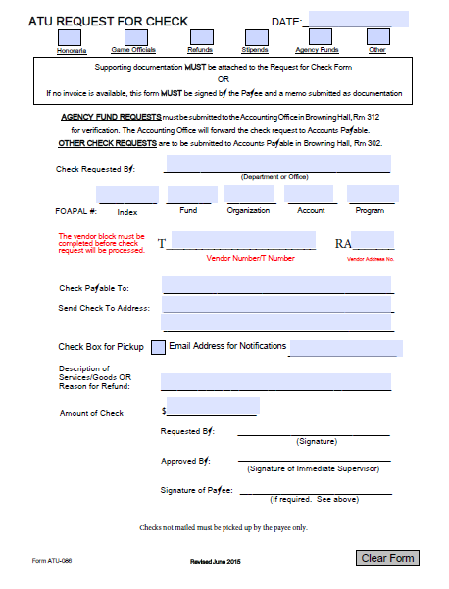
Request for Check Instructions
The Request for Check Form must be completed and submitted to Accounts Payable with supporting documentation in a timely manner. Incomplete forms will be returned, which will delay the payment process.
Please make sure that all required areas are filled in or marked appropriately.
Mark the type of check
Check Requested by: Department or Office
Correct FOAP: Fund, Organization, Account, & Program code for your department. (Account information can be found at www.atu.edu, under Purchasing, Faculty & Staff, Account Code Listing.)
Vendor Number/T Number (Refer to Banner)
Check Payable To
Send Check to Address (must match Invoice address)
Description of Goods/Services or Reason for Refund
Amount of Check
Requester Signature
Approval Signature
Signature of Payee (required when an invoice is not present, i.e. Stipends, game workers)
For Agency check request instructions, please visit the Forms page at www.atu.edu/controller.

Slide 10
Contract (special services)
Send the following forms together and forward to: Accounts Payable
Signed and approved Check Request Form
Invoice/Itemized Receipt (all receipts smaller than a standard sheet of paper should be taped to an 8 ½” x 11” sheet of paper, please do not staple)
Memo (if applicable)
Contract (special services)
Memo (if applicable)
Invoice/Itemized Receipt

Slide 11
Accounts Payable Contact Information
For questions regarding the Accounts Payable process please contact Jennifer Taylor for vendors A-L and Pcard payments, Traci Halsted for vendors M-Z, Tcard and travel reimbursements, Amber Meeks for Disbursing information or Melody Mayo, Accounts payable Supervisor.
All forms, instructions, and training are located on-line at: http://www.atu.edu/controller or under on-line forms at www.atu.edu.
Arkansas Tech University
Controller’s Office
404 N El Paso Ave
Russellville, Ar 72801

